Slide 1
Roles of Grid Computing and Autonomic Computing in Cloud Computing
Prepared by
Er.Harendra Bikram Shah
(Lecturer)
Department of Computer Engineering

Slide 2
OUTLINES
Introduction to Grid Computing
Distributed Computing in Grid and Cloud
Interoperability in Grids and Clouds
Introduction of Autonic Computing
Autonic Cloud Computing

Slide 3
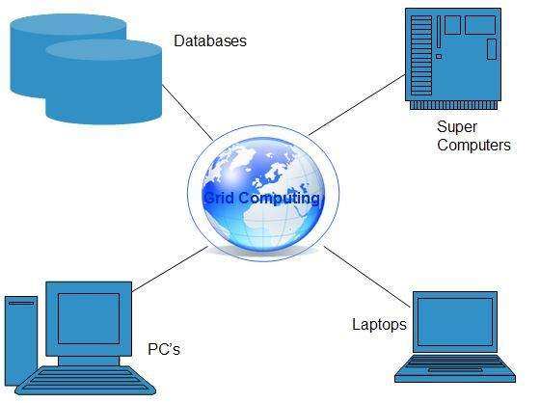
Introduction to Grid Computing
Grid Computing acts like a supercomputer by connecting many computers and resources across globe
These computer resources are heterogeneous and geographically dispersed.
Grid Computing breaks complex task into smaller pieces, which are distributed to CPUs that reside within the grid.
All machines on that network work under the same protocol to act like a virtual supercomputer

Slide 4
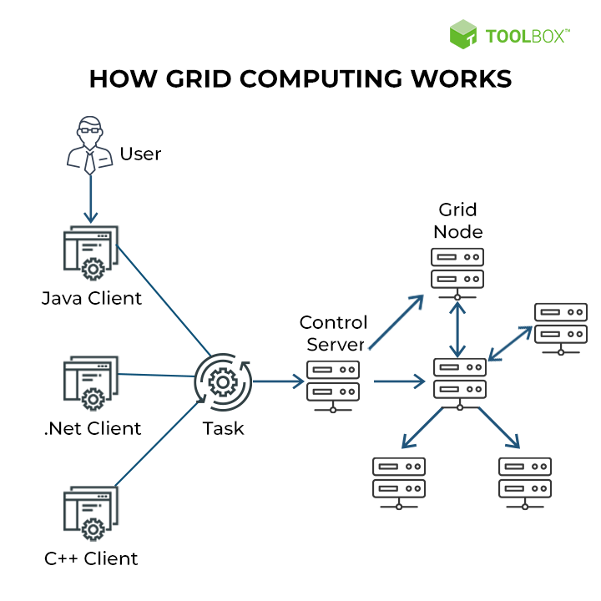

Slide 5
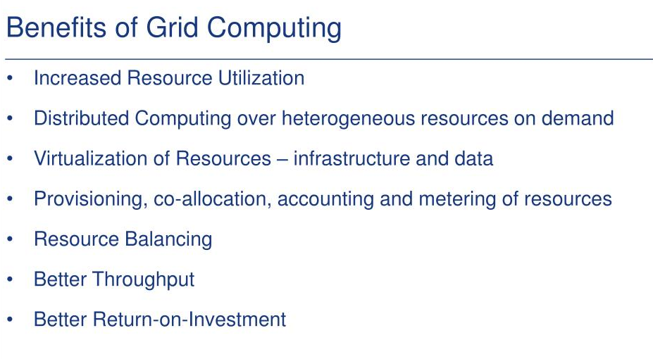
Ian Foster and Carl Kasselman published in 1999, the idea was to consume computing power like electricity is consumed from a power grid.

Slide 6
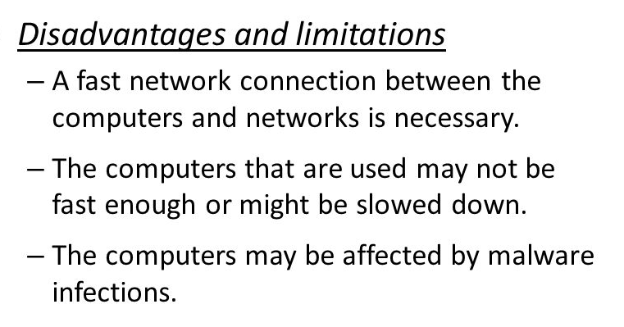

Slide 7
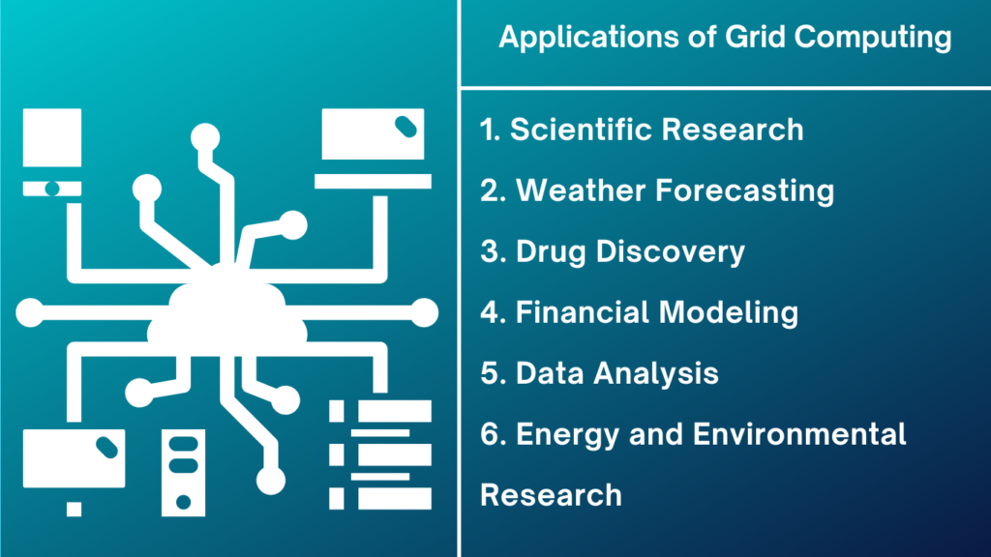

Slide 8
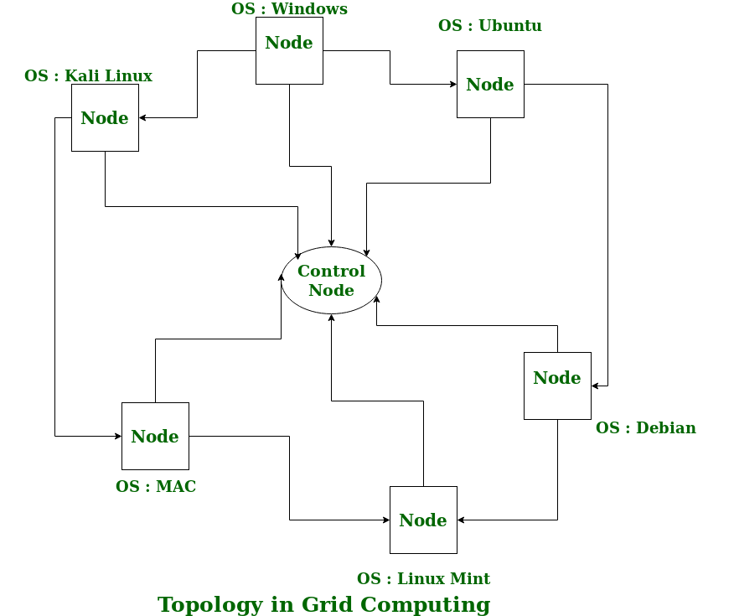

Slide 9
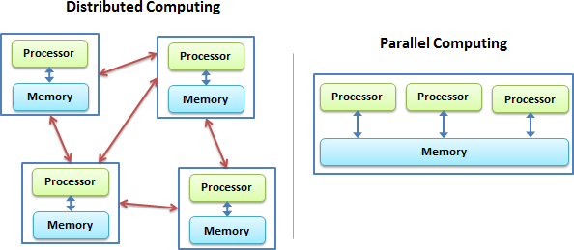
Distributed Computing in Grid and Cloud
Grid is based on grid computing where as cloud does not support Distributed computing as they have no mainly the automatic and instant scalability of resources.
Distributed computing concept evolved in 1995

Slide 10
INTEROPERABILITY IN GRIDS AND CLOUDS
both share the same vision of providing services
Both are based on network technology and are capable of multitasking
In grid computing, resources are distributed over grids, whereas in cloud computing, resources are managed centrally.

Slide 11
AUTONOMIC COMPUTING
Autonomic computing is a computer's ability to manage itself automatically
Learns automatically from learning the behaviour or activities of computer
to resolve system difficulties and other maintenance such as software updates.
Cut down the effort and time of developers and IT care takers.
It was proposed by Jiming Liu in the year 2001
IBM has defined the four areas of automatic computing:
Self-Configuration.
Self-Healing (error correction).
Self-Optimization (automatic resource control for optimal functioning).
Self-Protection (identification and protection from attacks in a proactive manner).
Characteristics that every autonomic computing system should have include
automation,
adaptivity and
awareness.
It uses artificial systems to solve complex problems using imitations like that of humans.

Slide 12
Characteristics
The Autonomic system knows itself.
It can configure itself again and again and run its setup automatically as and when required.
It has the capability of optimizing itself by fine-tuning workflows.
It can heal itself.
It can protect itself by detecting and identifying various attacks on it.
It can hide or optimize the resource
Autonomic Computing (AC) Architecture
It is based on MAPE Architecture : Monitor, Analyze, Plan and Execute
Control loops:
Managed Elements:
Sensors: .
Effectors:
Autonomic Manager:

Slide 13
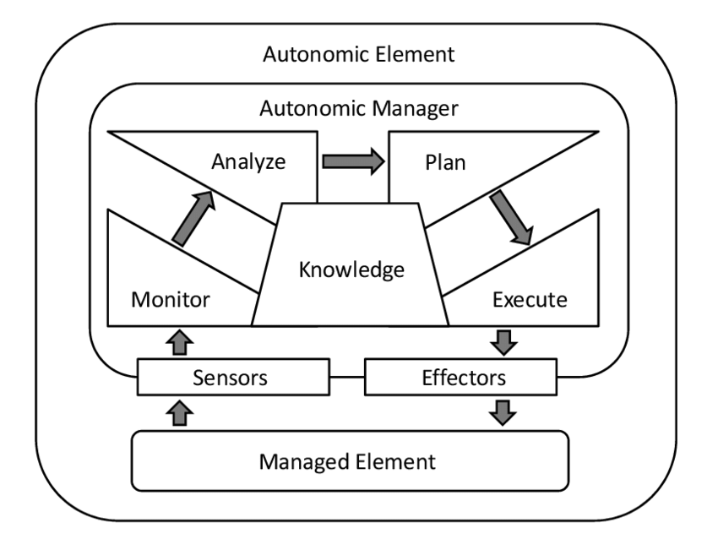
Autonomic Computing (AC) Architecture

Slide 14
Advantages
It is an open-source.
It is an evolutionary technology that adapts itself to new changes.
It is optimized hence gives better efficiency and performance thereby taking lesser time in execution.
It is very secure and can counter system and security attacks automatically.
It has backup mechanisms that allow recovery from system failures and crashes.
It reduces the cost of owning.
It can set up itself thereby reducing the time taken in manual setup.
Disadvantages
There will always be a possibility of the system crashing or malfunctioning.
This would result in an increase in unemployment due to the lesser needs of people after it is implemented.
The affordability would be an issue because it would be expensive.
It would need people who are very skilled
It is dependent on internet speed.

Slide 15
END of the UNIT 3

Slide 16
THANK YOU

